Slide 1
Design and Analysis of Algorithms
Algorithms-II : CS345A
Lecture 22
Before we state the topic …

Slide 2
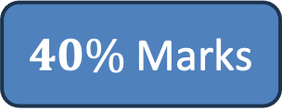
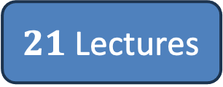
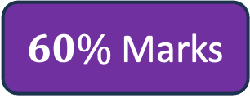

The Journey
Journey So Far
Journey Ahead
$21$Lectures
$18$Lectures
$40\%$Marks
$60\%$Marks
Mid semester Feedback

Slide 3
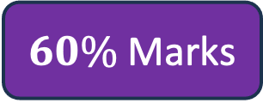

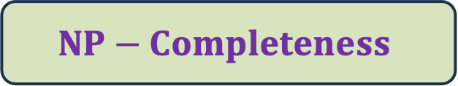


The Journey
Journey Ahead
$$Network Flows$$
$18$Lectures
$$Amortized Analysis$$
$$NP−Completeness$$
$60\%$Marks

Slide 4
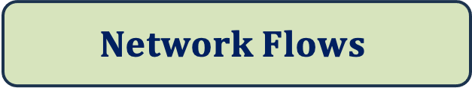
$$Network Flows$$
Elegance
Depth
A famous graph theorem
Wide Applications
Perhaps the most elegant, intuitive, and fresh
Much deeper analysis than Bellman Ford algorithm
MaxFlow-MinCut Theorem
Wider than MST, DFS, Dijkstra’s algorithm

Slide 5
Maximum Flow in a Network

Slide 6
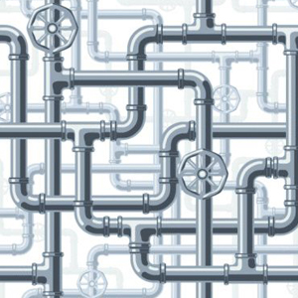
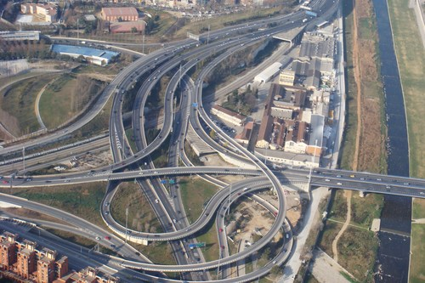
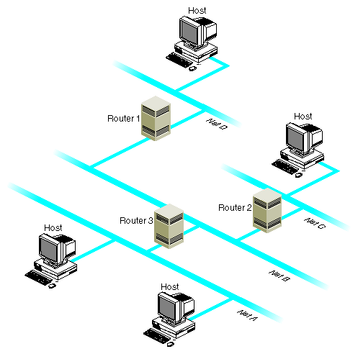
Network

Slide 7







Problem definition (Informal)
2
Given a network, where each edge has a certain capacity,
there is a designated source vertex $s$and sink vertex $t$.
Compute the maximum flow that we can send from $s$to $t$.
$$v$$
$$x$$
5
6
15
8
$$t$$
$$s$$
6
7
14
7
17
$$u$$
4
$$y$$

Slide 8
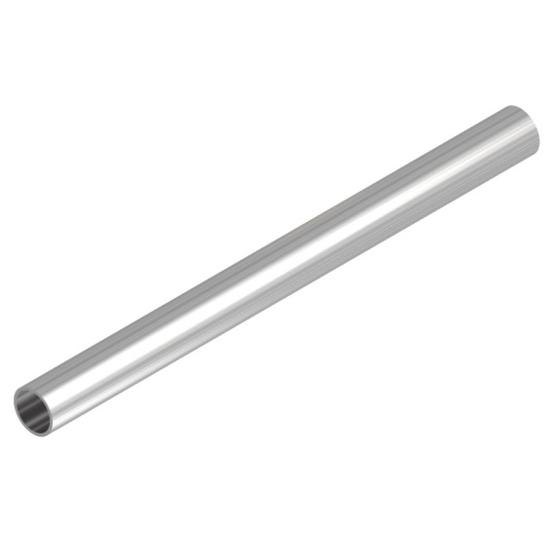
Question: What is flow along an edge ?
Answer: The rate at which the commodity is being transported along the edge.
Question: What is capacity of an edge ?
Answer: The maximum rate at which the commodity can be transported
along the edge.
Example: 25 litre/sec
1 GB /sec
An edge

Slide 9





Are there any constraints for a flow ?
$$x$$
$≤$25
Capacity constraint :
Flow along an edge cannot exceed its capacity
Conservation constraint :
Flow entering node $u$ = Flow leaving node $u$.
25
$$u$$
5
$$u$$
25
20

Slide 10
Formal Description of Flow

Slide 11
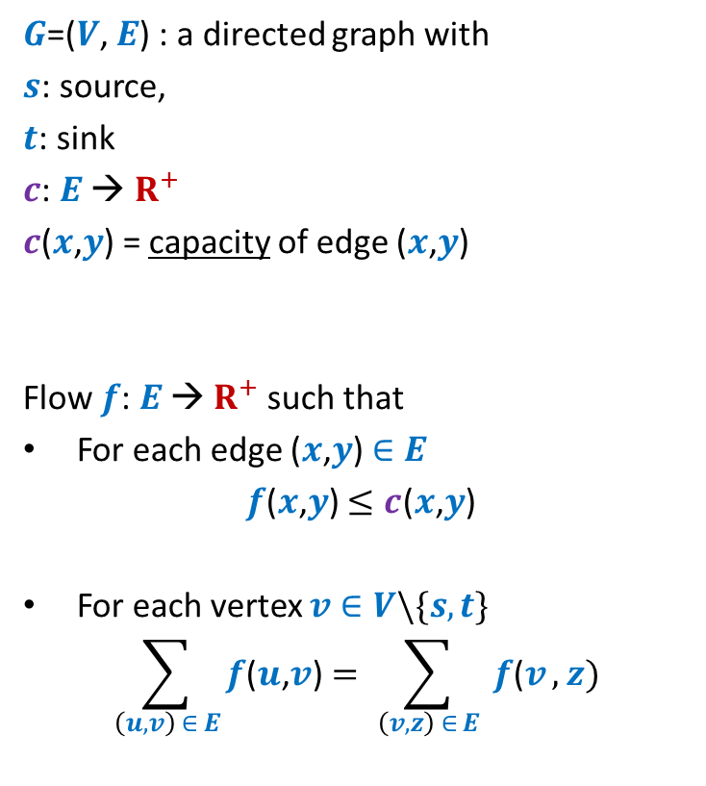
Formal Description of Flow
2
$G$=($V$, $E$) : a directed graph with
$s$: source,
$t$: sink
$c$: $E$ → $R^{+}$
$c$($x$,$y$) = capacity of edge ($x$,$y$)
Flow $f$: $E$ → $R^{+}$ such that
For each edge ($x$,$y$) $∈E$
$f$($x$,$y$) $≤c$($x$,$y$)
For each vertex $v∈V\backslash \{s,t\}$
$$\sum_{\left(u,v\right) ∈ E}{f\text{(}u\text{,}v\text{)}}=\sum_{ \left(v,z\right) ∈ E }{f\text{(}v},z)$$
$$v$$
$$x$$
5
6
15
8
$$t$$
$$s$$
6
7
14
7
17
$$u$$
4
$$y$$
Capacity constraint
Conservation constraint

Slide 12

Formal Description of Flow
2
$\text{value}\text{(}f\text{)=}$ flow leaving $s$
$$=\sum_{\left(s,v\right) ∈ E}{f\text{(}s\text{,}v\text{)}}$$
$G$=($V$, $E$) : a directed graph with
$s$: source,
$t$: sink
$c$: $E$ → $R^{+}$
$c$($x$,$y$) = capacity of edge ($x$,$y$)
Flow $f$: $E$ → $R^{+}$ such that
For each edge ($x$,$y$) $∈E$
$f$($x$,$y$) $≤c$($x$,$y$)
For each vertex $v∈V\backslash \{s,t\}$
$$\sum_{\left(u,v\right) ∈ E}{f\text{(}u\text{,}v\text{)}}=\sum_{ \left(v,z\right) ∈ E }{f\text{(}v},z)$$
$$v$$
$$x$$
4
5
5
11
6
1
15
8
$$t$$
$$s$$
6
7
1
7
7
14
7
17
$$u$$
4
$$y$$
It takes $O(m+n)$ time to verify if $f$ is a valid flow.

Slide 13
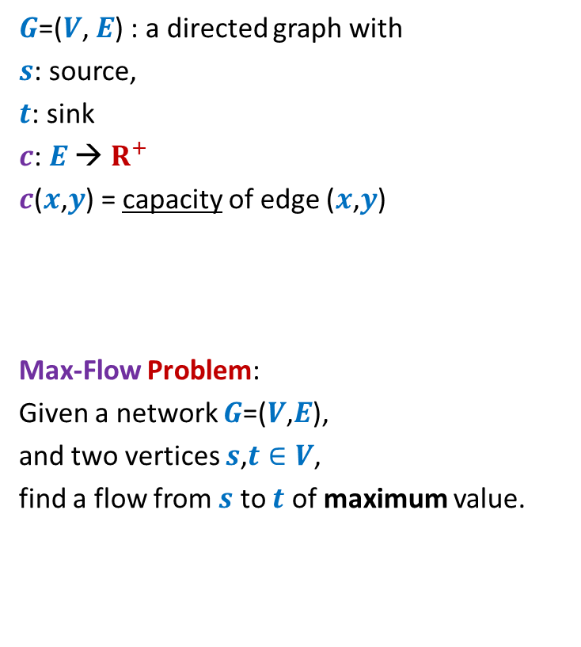
Formal Description of Flow
2
$\text{value}\text{(}f\text{)=}$ flow leaving $s$
$$=\sum_{\left(s,v\right) ∈ E}{f\text{(}s\text{,}v\text{)}}$$
$G$=($V$, $E$) : a directed graph with
$s$: source,
$t$: sink
$c$: $E$ → $R^{+}$
$c$($x$,$y$) = capacity of edge ($x$,$y$)
Max-Flow Problem:
Given a network $G$=($V$,$E$),
and two vertices $s$,$t∈V$,
find a flow from $s$ to $t$ of maximum value.
$$v$$
$$x$$
5
6
15
8
$$t$$
$$s$$
6
7
14
7
17
$$u$$
4
$$y$$

Slide 14





Towards designing max flow algorithm
2
$$v$$
$$x$$
5
6
15
Can we handle simpler graphs ?
8
$$t$$
$$s$$
6
7
14
7
17
$$u$$
4
$$y$$

Slide 15
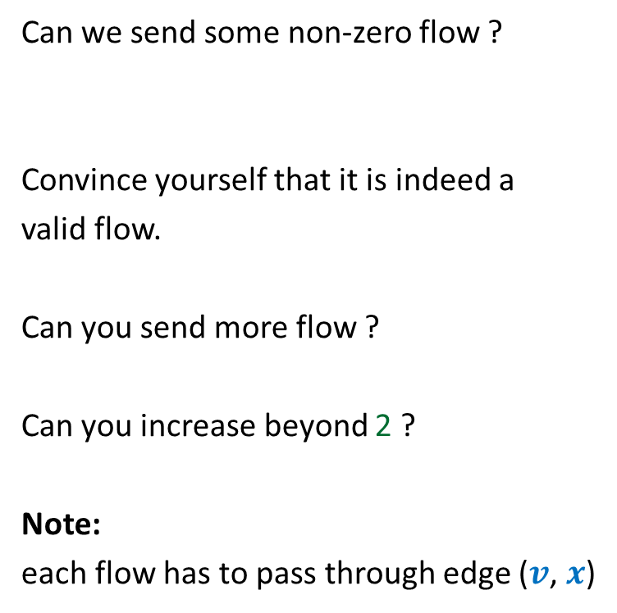


Towards designing max flow algorithm
Can we send some non-zero flow ?
Convince yourself that it is indeed a
valid flow.
Can you send more flow ?
Can you increase beyond 2 ?
Note:
each flow has to pass through edge ($v$, $x$)
$$v$$
$$x$$
6
5
15
$$t$$
$$s$$
1
2
1
1
2
2

Slide 16
Towards designing max flow algorithm
We can compute maximum flow in a path easily.
$$v$$
$$x$$
Let us see how we can use this knowledge for any directed graph?
6
5
15
$$t$$
$$s$$
5
5
5
Bottleneck edge

Slide 17
Towards designing max flow algorithm
You will be shown some animation to help you think about the natural approach.
Watch them slowly with attentive mind ☺
2
$$v$$
$$x$$
5
6
15
What is the most natural approach to solve this problem ?
8
$$t$$
$$s$$
6
7
14
7
17
$$u$$
4
$$y$$
A drop of water
or a bit originating at source.

Slide 18
Towards designing max flow algorithm
2
$$v$$
$$x$$
5
6
15
8
$$t$$
$$s$$
6
7
14
7
17
$$u$$
4
$$y$$

Slide 19
Towards designing max flow algorithm
2
$$v$$
$$x$$
5
6
15
8
$$t$$
$$s$$
6
7
14
7
17
$$u$$
4
$$y$$
Another drop of water
or a bit originating at source.

Slide 20
Towards designing max flow algorithm
2
$$v$$
$$x$$
5
Could you now get the most natural approach to solve this problem ?
6
15
8
$$t$$
$$s$$
6
7
14
7
17
$$u$$
4
$$y$$

Slide 21
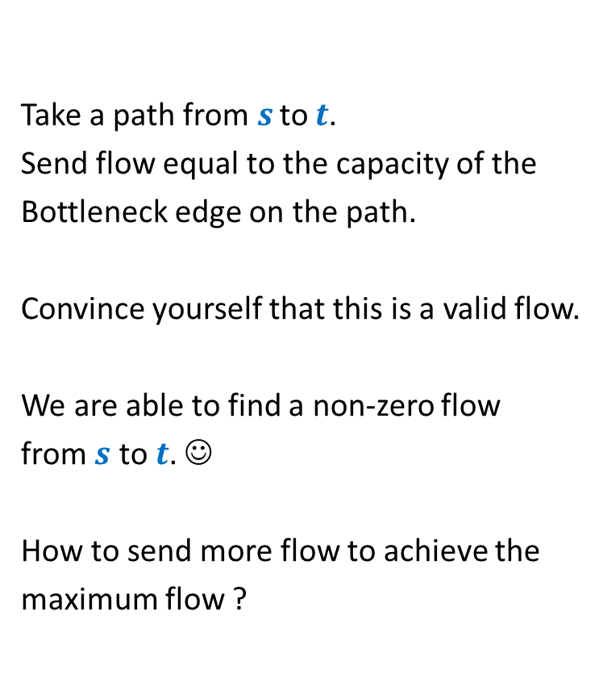
Towards designing max flow algorithm
2
Update the capacities of the edges.
And …
Find another path ☺
Take a path from $s$ to $t$.
Send flow equal to the capacity of the
Bottleneck edge on the path.
Convince yourself that this is a valid flow.
We are able to find a non-zero flow
from $s$ to $t$. ☺
How to send more flow to achieve the
maximum flow ?
$$v$$
5
$$x$$
5
5
0
5
6
10
1
15
8
$$t$$
$$s$$
6
7
14
7
17
$$u$$
4
$$y$$

Slide 22

Towards designing max flow algorithm
2
Update the capacities of the edges.
And …
Find another path ☺
$$v$$
5
$$x$$
5
0
$+$1
5
0
1
10
8
$$t$$
$$s$$
6
1
1
14
7
16
7
6
17
$$u$$
4
$$y$$

Slide 23

Towards designing max flow algorithm
2
Update the capacities of the edges.
And …
Find another path ☺
$$v$$
5
$$x$$
6
0
5
$+$7
0
3
10
8
$$t$$
$$s$$
6
7
1
1
7
7
7
14
6
16
0
$$u$$
4
$$y$$

Slide 24


Towards designing max flow algorithm
2
2
$$v$$
$$x$$
We are unable to find any path from $s$ to $t$ of non-zero capacity.
Let us bring the original network to see how far we have reached ☺
We can send flow at most $13$ from $s$ to $t$
$$v$$
5
$$x$$
5
5
6
0
6
12
12
15
0
3
6
$$t$$
8
6
$$t$$
8
6
$$s$$
$$s$$
7
7
1
1
1
1
7
7
7
14
7
17
0
7
6
16
4
$$u$$
4
$$y$$
$$u$$
$$y$$

Slide 25

Towards designing max flow algorithm
2
2
$$v$$
$$x$$
We can send flow at most $13$ from $s$ to $t$
$$v$$
5
$$x$$
5
5
6
0
6
12
12
15
0
3
6
$$t$$
8
6
$$t$$
8
6
$$s$$
$$s$$
7
1
1
7
1
1
7
7
7
14
7
17
0
7
6
16
4
$$u$$
4
$$y$$
$$u$$
$$y$$
We are sending flow of value $13$.
We found Maximum Flow in this network.

Slide 26
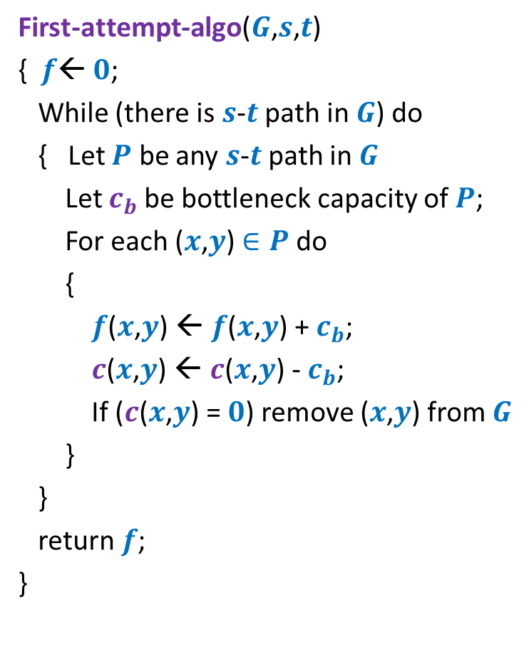
Towards designing max flow algorithm
First-attempt-algo($G$,$s$,$t$)
{ $f$← $0$;
While (there is $s$-$t$ path in $G$) do
{ Let $P$ be any $s$-$t$ path in $G$
Let $c_{b}$be bottleneck capacity of $P$;
For each ($x$,$y$) $∈P$ do
{
$f$($x$,$y$) ← $f$($x$,$y$) + $c_{b}$;
$c$($x$,$y$) ← $c$($x$,$y$) - $c_{b}$;
If ($c$($x$,$y$) = $0$) remove ($x$,$y$) from $G$
}
}
return $f$;
}
Correctness ?

Slide 27
A counterexample for First-attempt-algo

Slide 28

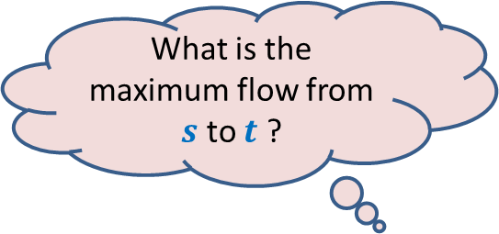



$$x$$
What is the maximum flow from $s$ to $t$ ?
20
10
20
10
$$s$$
10
50
$$t$$
30
10
20
10
20
$$y$$

Slide 29


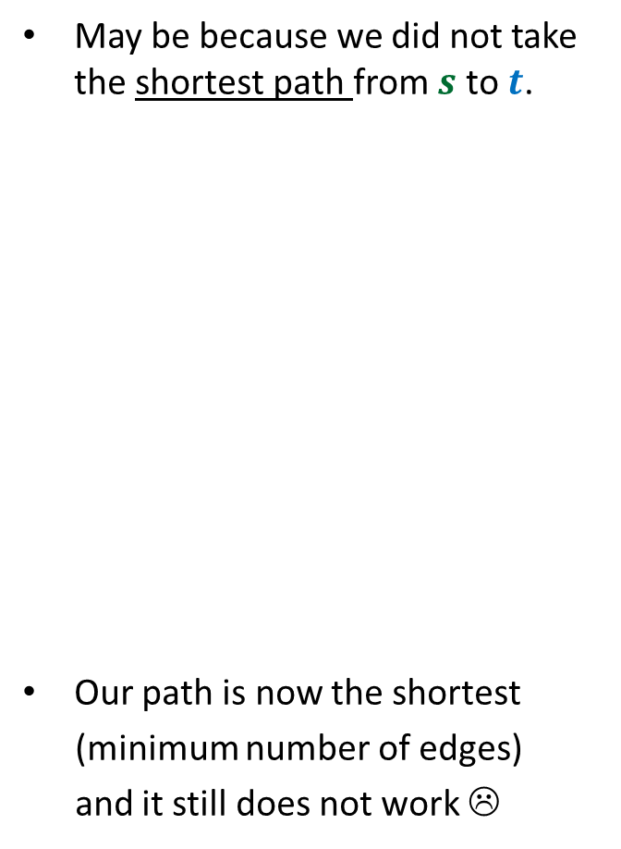


Executing our first attempt algorithm
May be because we did not take the shortest path from $s$ to$t$.
Our path is now the shortest
(minimum number of edges)
and it still does not work ☹
$$x$$
$$x$$
20
20
10
10
$$s$$
20
50
$$t$$
$$s$$
30
$$t$$
20
10
20
10
$$y$$
$$y$$
No $s−t$ path

Slide 30
Homework
Spend at least 1 hour today on the following task
Work on this counterexample
and pursue a pure scientific approach
to modify the existing algorithm so that it may compute the maximum flow…
In particular, try to find a way to send the remaining 10 units of flow.

Slide 31
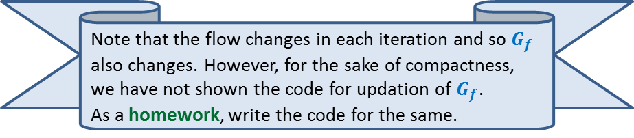
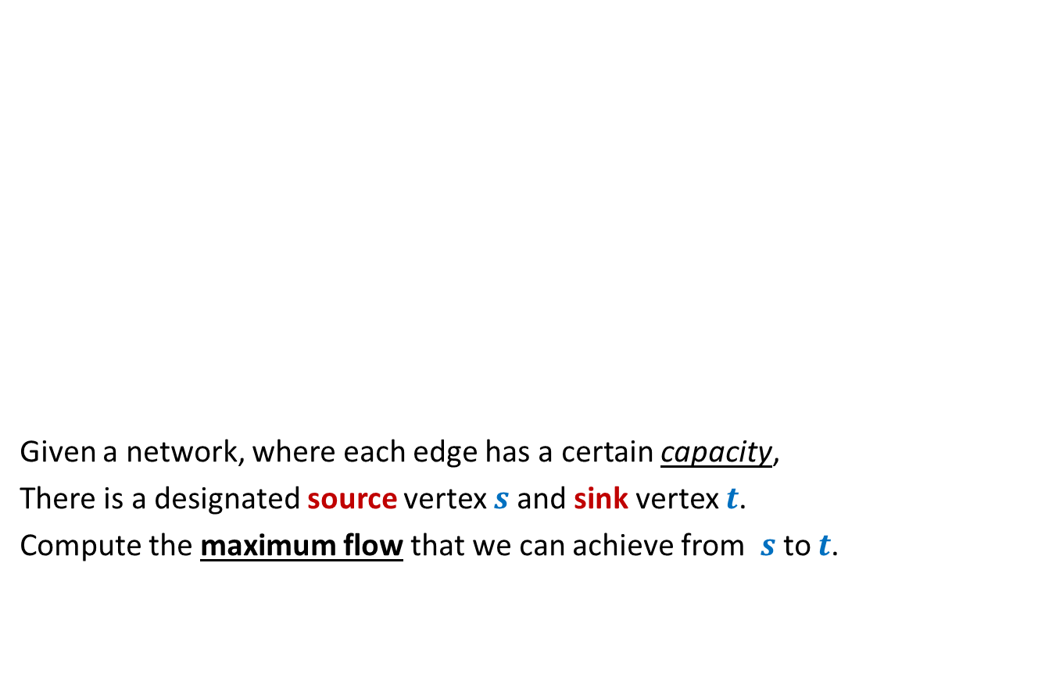

Rounding of a matrix
$$11$$
$$11.7$$
$$12$$
$$39$$ | $$19$$ | $$18$$ | $$30$$
$$37$$
$$15$$
$$20$$
$$34$$
$$11.7$$ | $$2.4$$ | $$4.3$$ | $$18.6$$
$$5.2$$ | $$6.1$$ | $$1.0$$ | $$2.7$$
$$6.7$$ | $$3.6$$ | $$9.1$$ | $$0.6$$
$$15.4$$ | $$6.9$$ | $$3.6$$ | $$8.1$$
$$12$$ | $$2$$ | $$4$$ | $$19$$
$$5$$ | $$6$$ | $$1$$ | $$3$$
$$7$$ | $$4$$ | $$9$$ | $$0$$
$$15$$ | $$7$$ | $$4$$ | $$8$$
An amazing application of max flows.
Design an algorithm to round a $n×n$ matrix, if possible ?
Rounding always exists !
Rounding can be computed efficiently.
Using Max Flow ☺

